Slide 1
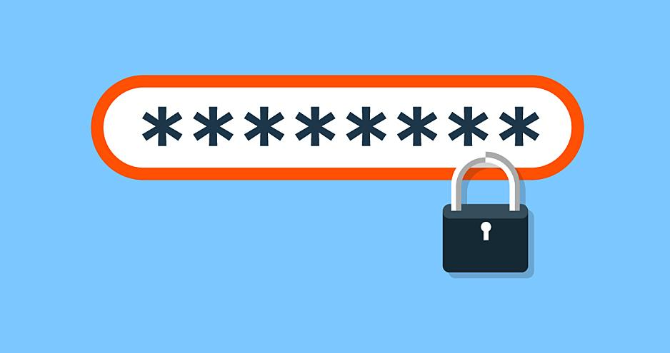
Password Cracking
‘1234abcd’

Slide 2
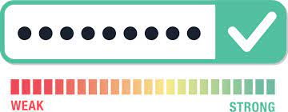
What are Passwords?
Come on guys, you know this…..
A string of characters to authenticate things like your computer, phone, files, internet…
AND YOUR LIFE!

Slide 3
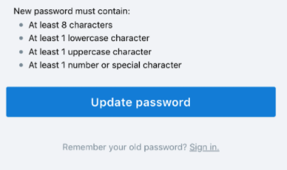
What Should EVERY Password Contain?
Letters
Lower-case [a-z]
CAPITAL [A-Z]
Numbers
0-9
Special Characters
! @ # $ % & *

Slide 4
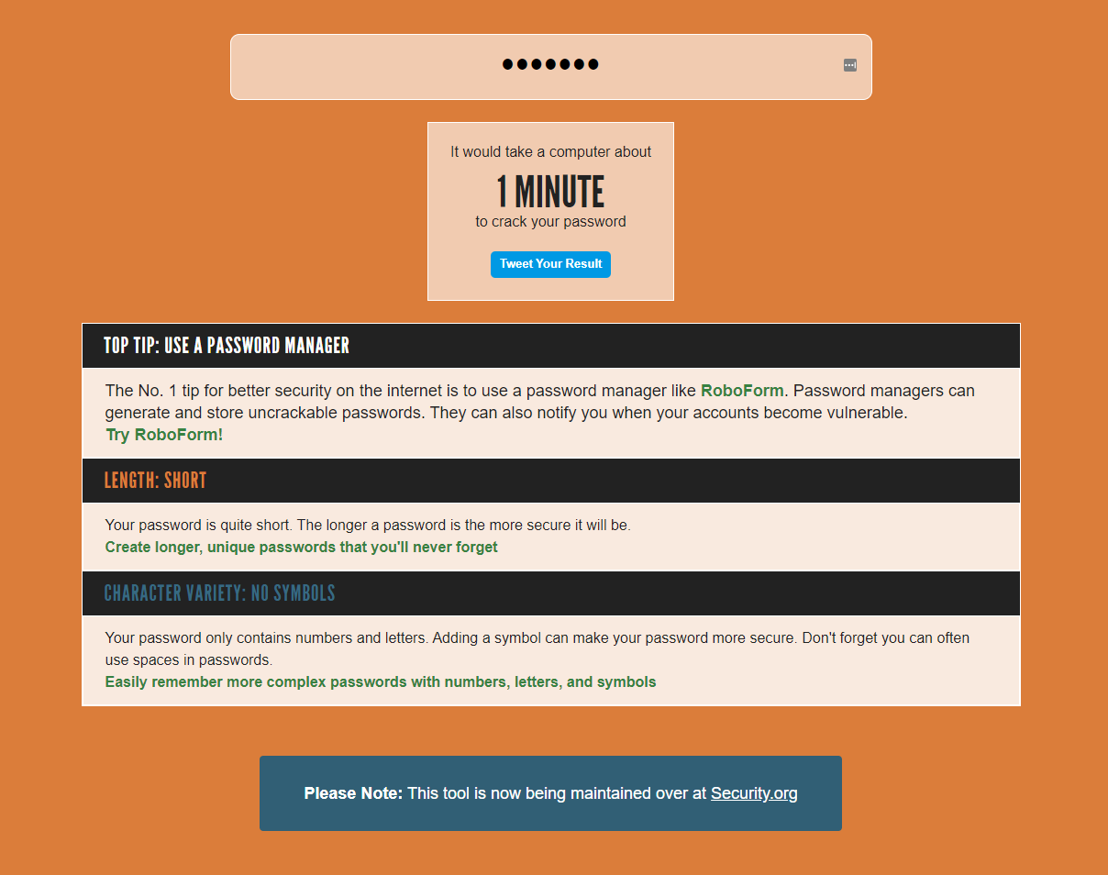
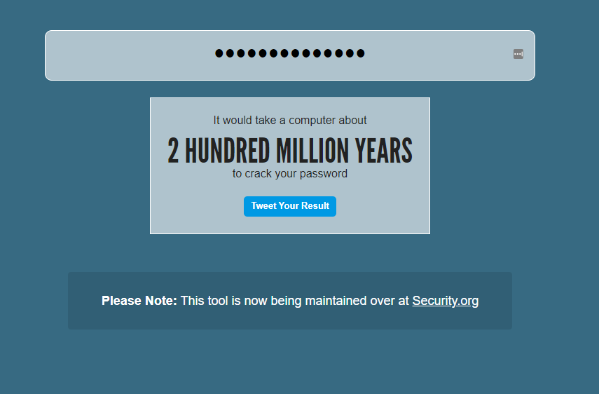
Test Your Password!
I want to know your password….
https://howsecureismypassword.net/

Slide 5
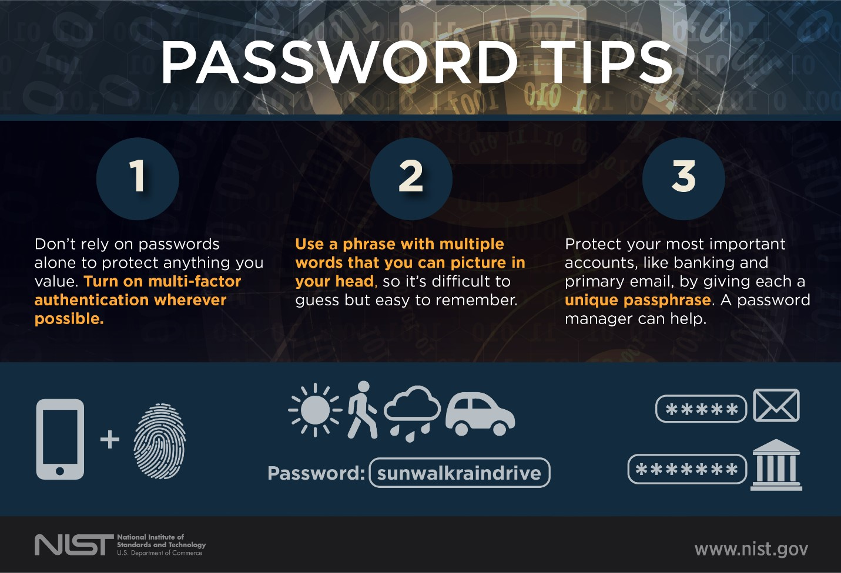
Characteristics of a Good Password
Not short in length
No personal information
Real Name
Birthday
Phone Number
Not the end all be all
While you can make a password VERY strong, you should always have a backup. Use 2FA!

Slide 6
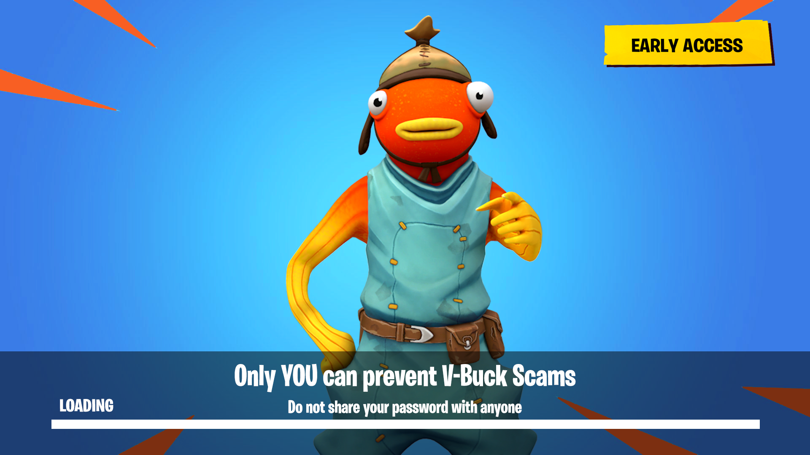
What NOT to do!
Don’t use passwords you’ve used in the past.
Don’t use the same password for multiple accounts or devices.
NEVER SHARE YOUR PASSWORD!.

Slide 7
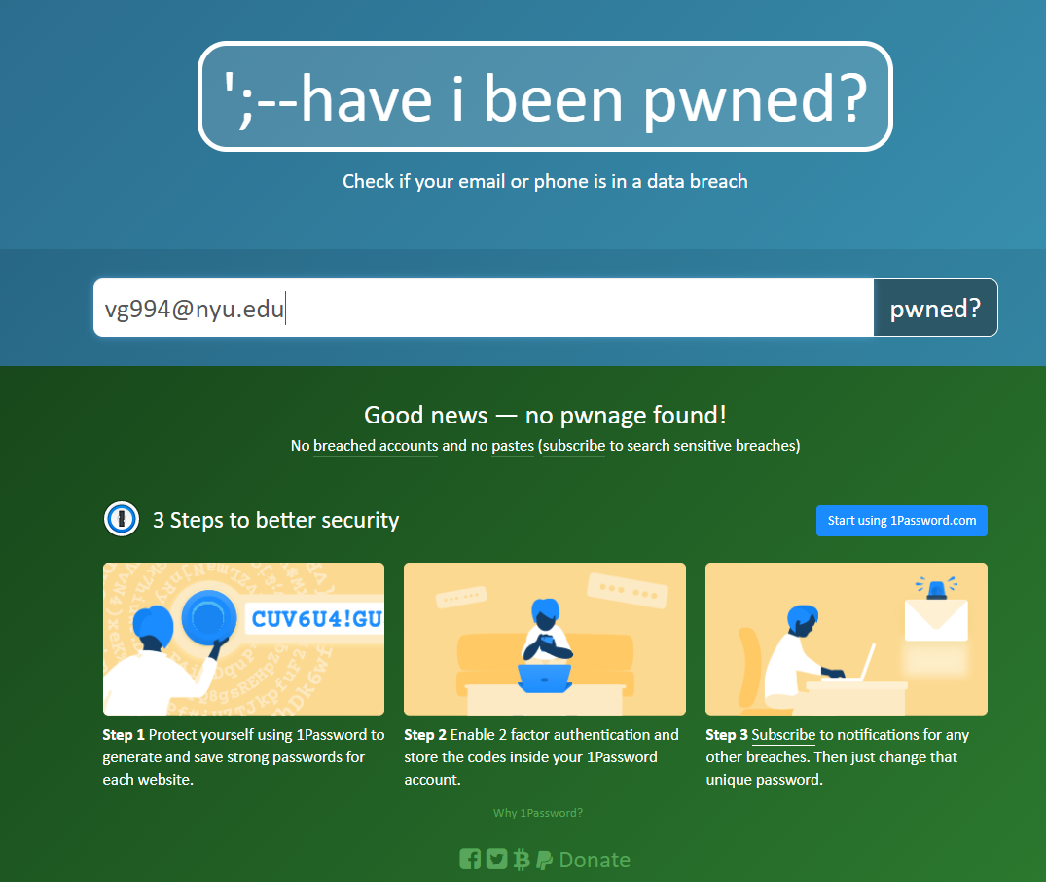
Have you been PWNED?
https://haveibeenpwned.com/

Slide 8
Preventative Measures
Use a Password Manager!
LastPass
BitWarden
NordLocker

Slide 9
Now, if you don’t do this….

Slide 10
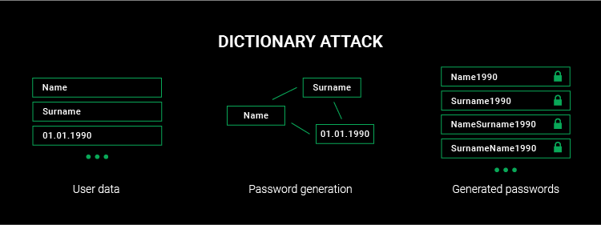
Types of Password Attacks
Dictionary Attack
Brute Force Attack
Phishing
Social Engineering
Malware
Guessing

Slide 11
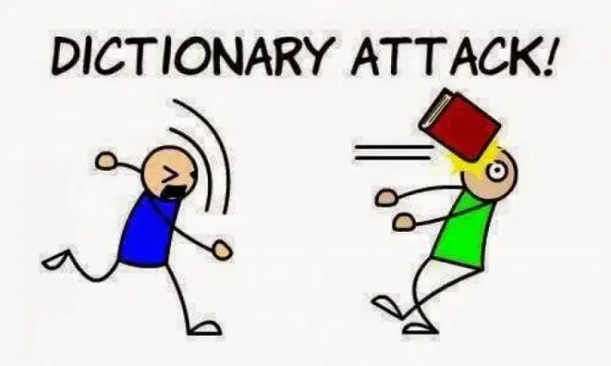
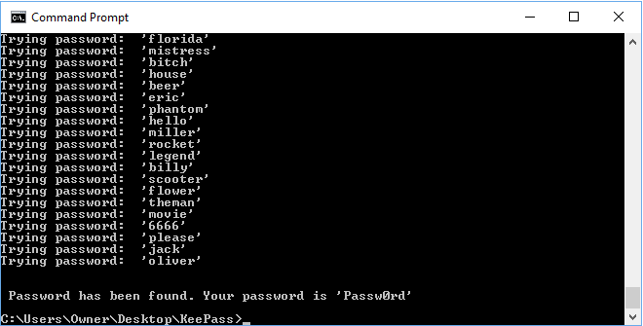
Dictionary & Brute Force Attacks
Brute Force Attacks
Testing EVERY word possibility till you get the password.
Dictionary Attacks
Uses a created list of words to reference and test possibilities.
Same approach
Testing EVERY possibility till it gets it right.
Dictionary attack is much more efficient assuming you have the right word list.
If you are given a password hint.

Slide 12
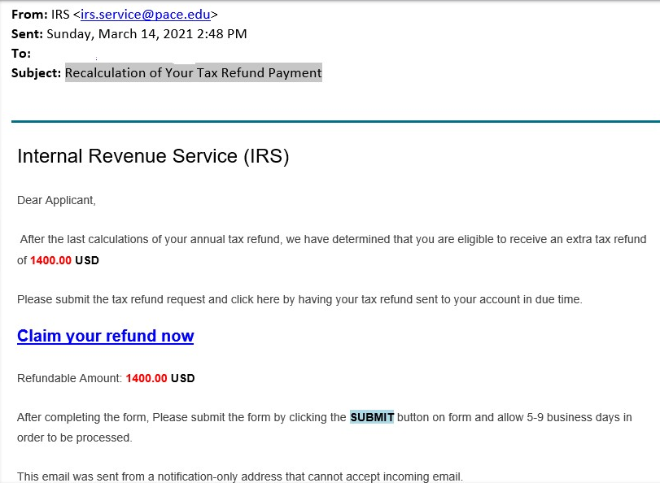
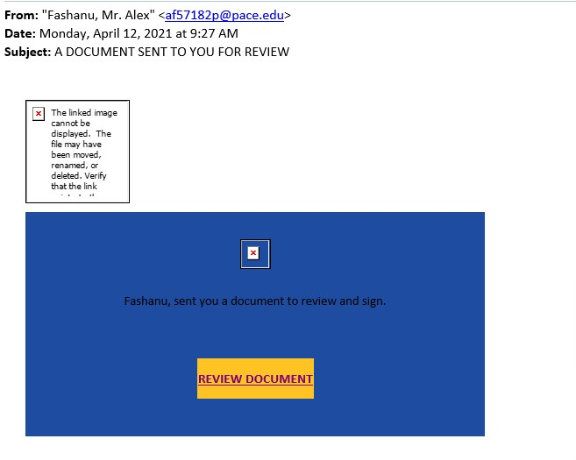
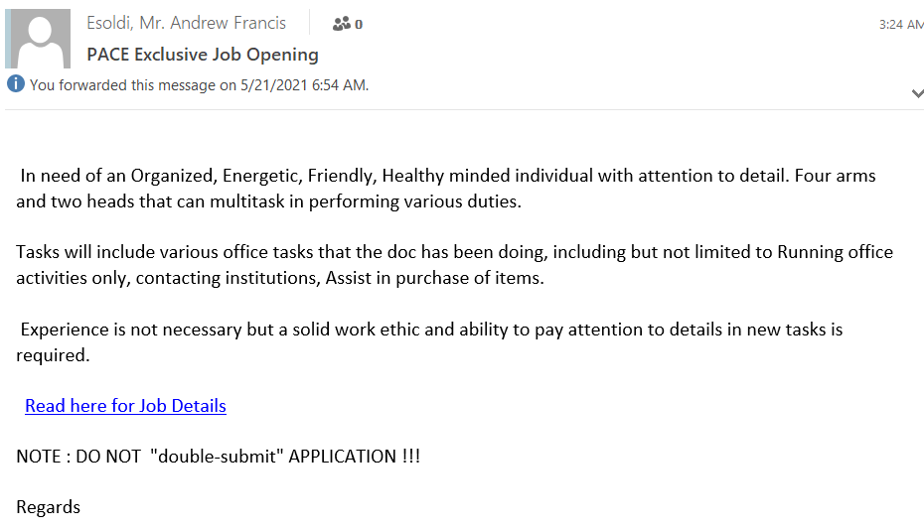
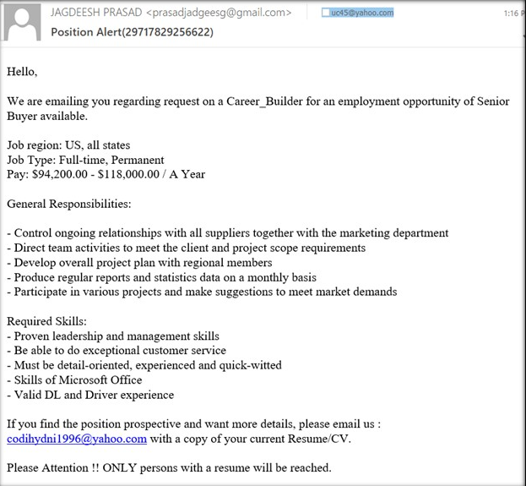
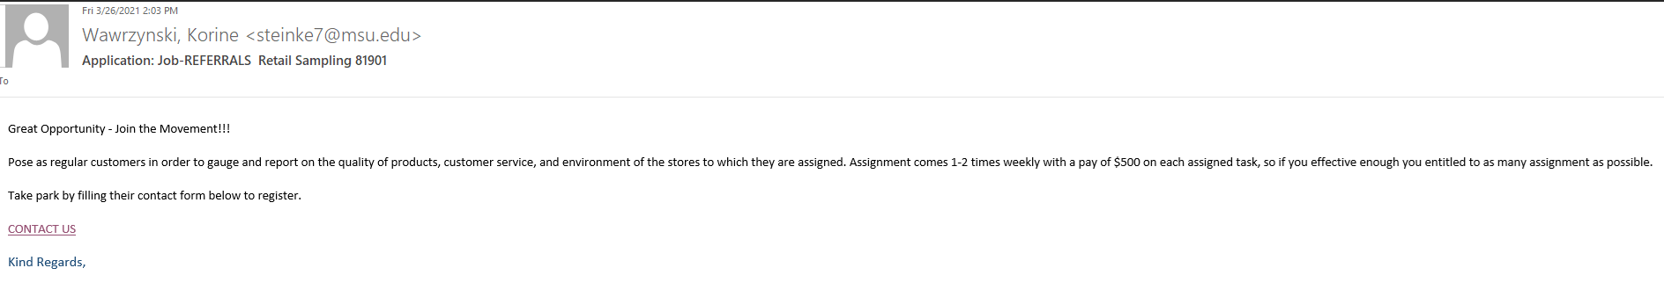
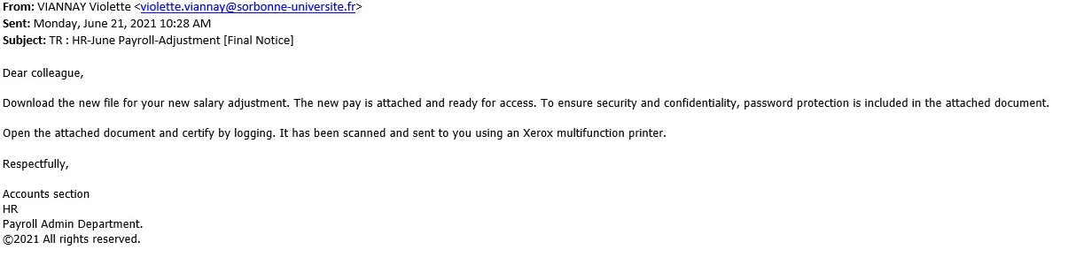
Phishing

Slide 13

Social Engineering

Slide 14

Social Engineering (cont.)
The use of deception to manipulate individuals into divulging confidential or personal information that may be used for fraudulent purposes. (PASSWORDS!)

Slide 15

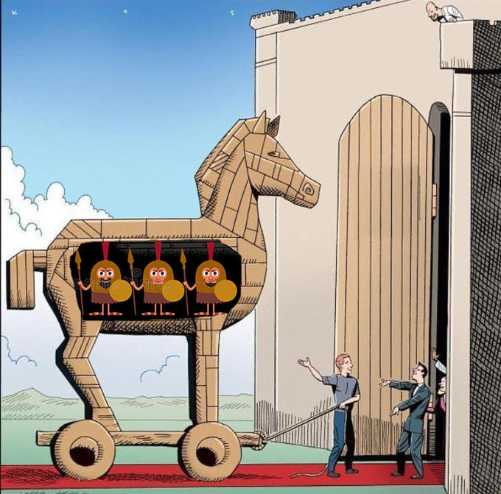
Malware
Trojan Horse
Keylogger

Slide 16

Guessing
If I know you personally, and I know what you like, I can easily guess what your password may be.
My password is MarvelLover3000.

Slide 17


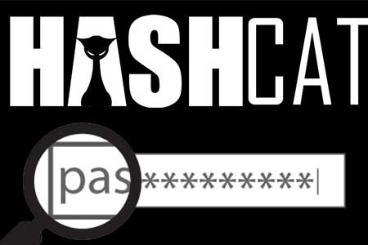

Tools that Actually do this Stuff!
Cain and Abel
AirCrack -NG
John the Ripper
Hashcat

Slide 18
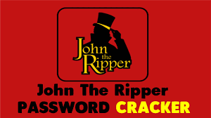
For Activity 1, we’ll be using John the Ripper
Don’t worry, he won’t kill you
John the Ripper is an Open Source password security auditing and password recovery tool available for many operating systems.
Able to use this program offline
VERY powerful, has several built in crackers for various types of passwords.
Linux based

Slide 19
Demo!
Try to open this, tell me what happens:
https://drive.google.com/file/d/1cqYVBXKJTER2564_ewMxqIzGdhcakd72/view?usp=sharing

Slide 20
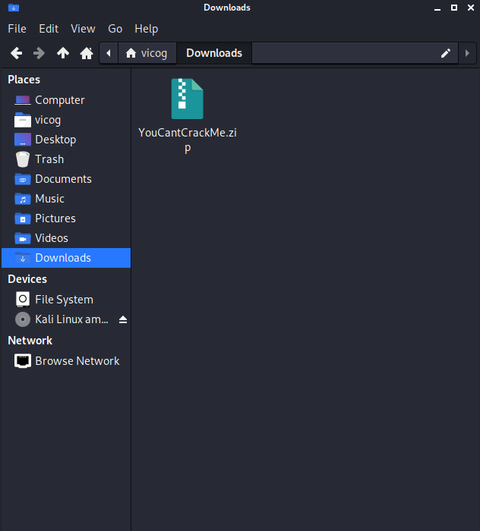
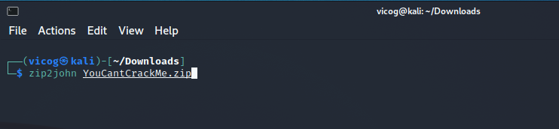
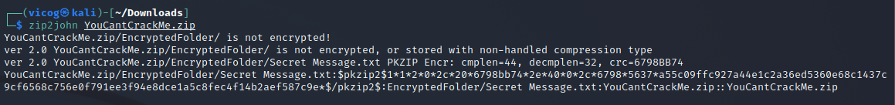
Do you know the Password?
No.
But you will, let’s go through it step by step
Step 1:

Slide 21
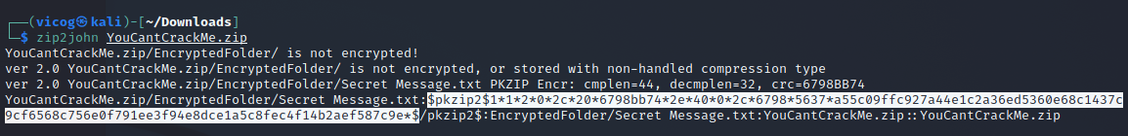
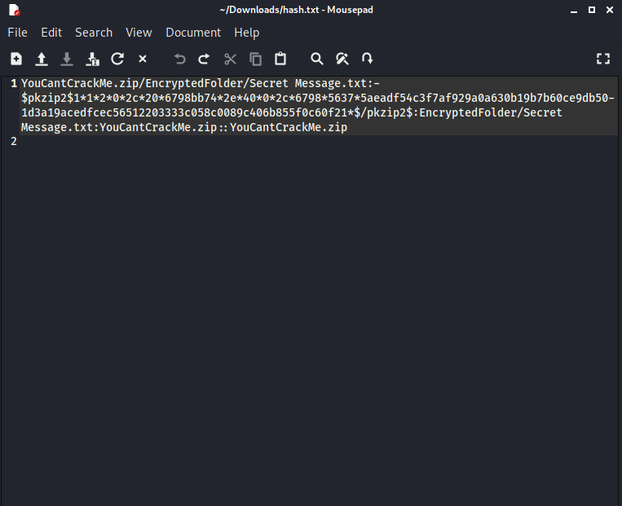
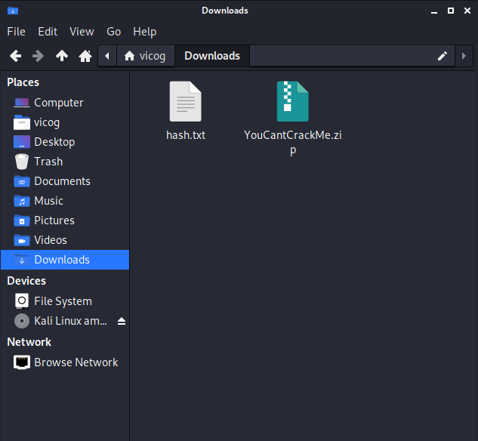
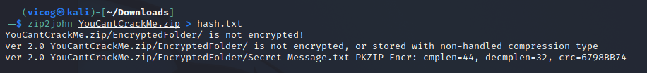
Do you know the Password? (cont.)
Step 2:

Slide 22
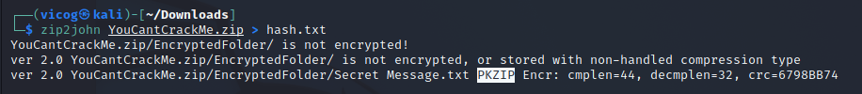
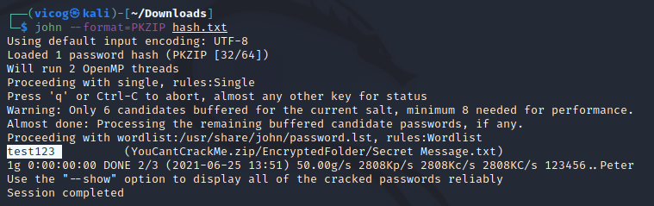
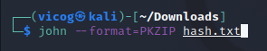
Do you know the Password? (cont.)
Step 3:

Slide 23
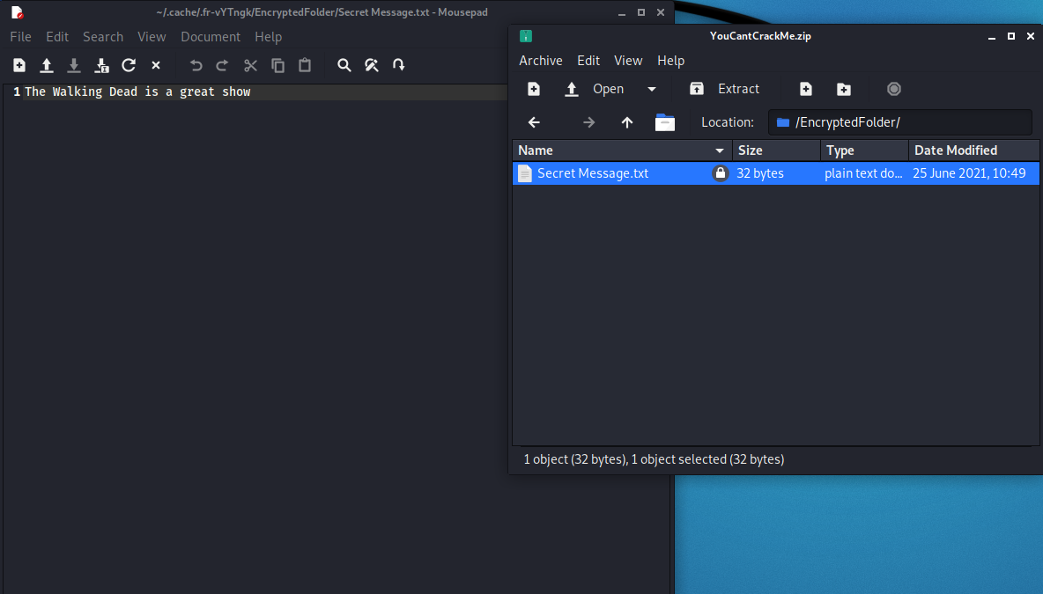
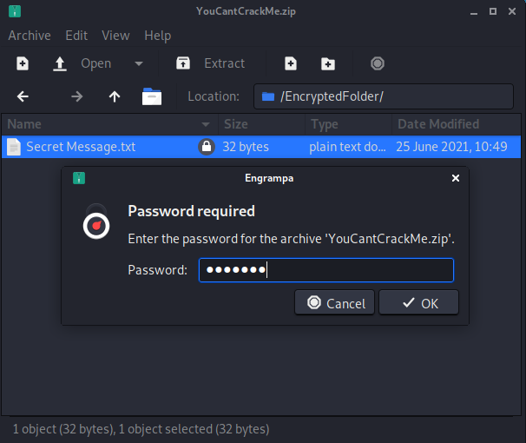
Did it work?
Step 4:

Slide 24
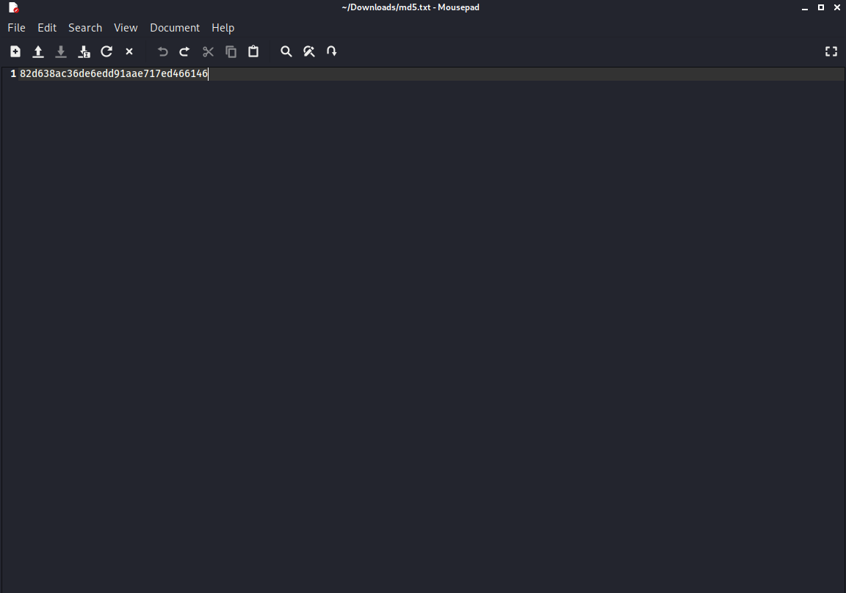
Activity 2: Cracking MD5 Hashes using Hashcat
Open this, what’s in it?
https://drive.google.com/file/d/1f3dN23p87QcSPQV94NeL7O_4XqnCiwkT/view?usp=sharing

Slide 25
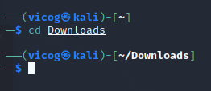
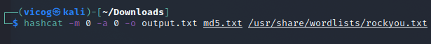
Hashcat Terminal Command
Tells Hashcat what hash you want to crack
0 = MD5
100 = SHA1
Tells Hashcat what attack mode to use.
0 = Straight
3 = Brute-force
Setting file with MD5 encoded password(s) you want to be decoded
Setting wordlist you want to use as a reference to attempt to crack the password
Setting output file where decoded password would be
https://hashcat.net/wiki/doku.php?id=hashcat

Slide 26
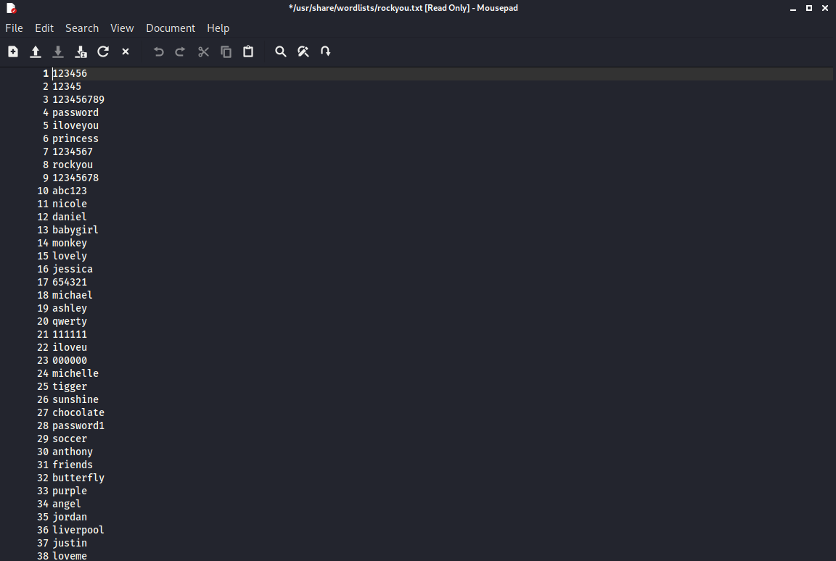
Wordlists
Wordlists are files with THOUSANDS of possible words that can be your password. Programs like John the Ripper and Hashcat use these wordlists to test which word is correct. Wordlists are very important when using these programs.

Slide 27
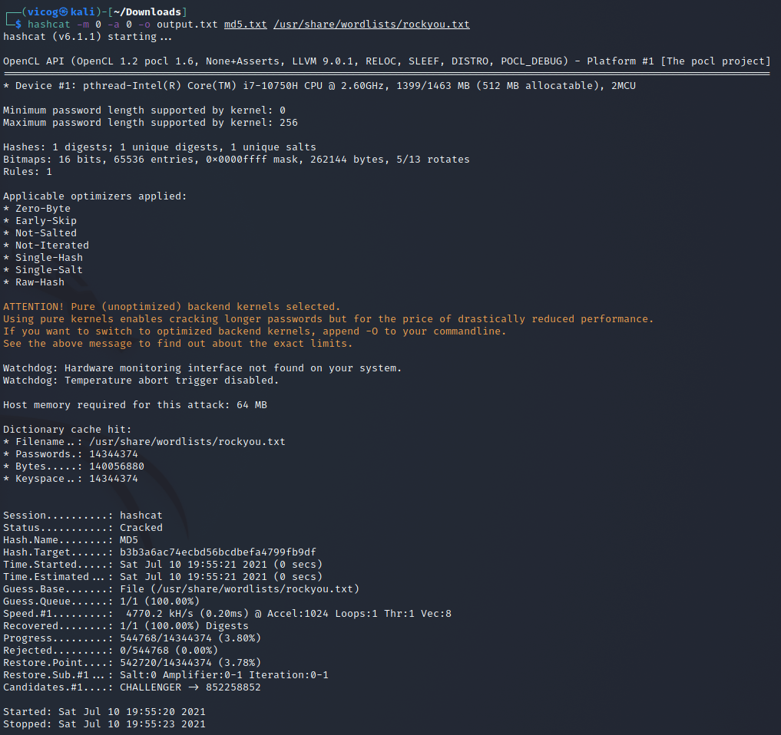
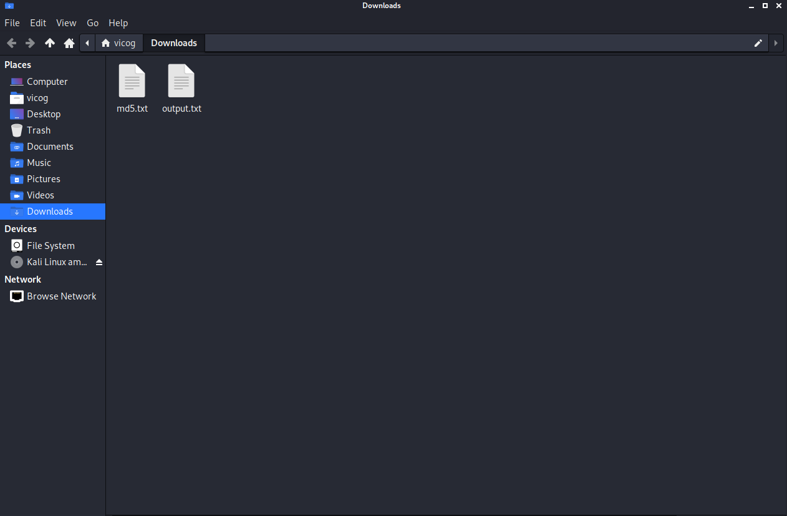
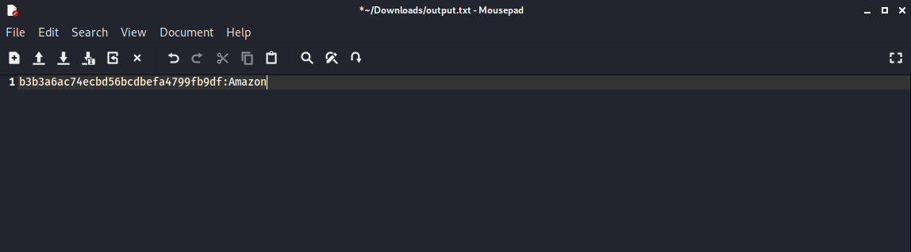
Did it Work?

Slide 28

YOU DID IT!

